Slide 1

Building the Next Generation Teaching and Learning Environment with Tsugi (次)
Charles Severance
University of Michigan School of Information
www.tsugi.org

Slide 2
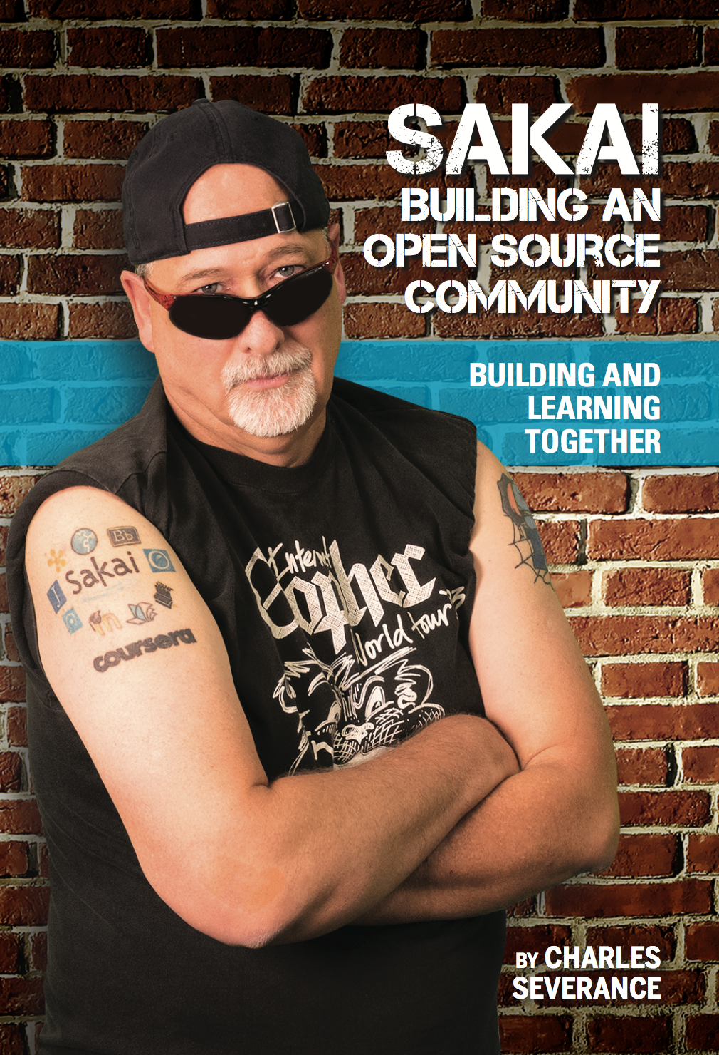
Enterprise Learning Management System (LMS) Been there – done that – got the tattoo.. But…

Slide 3

http://planet-fall.deviantart.com/art/The-Monolith-80407794

Slide 4
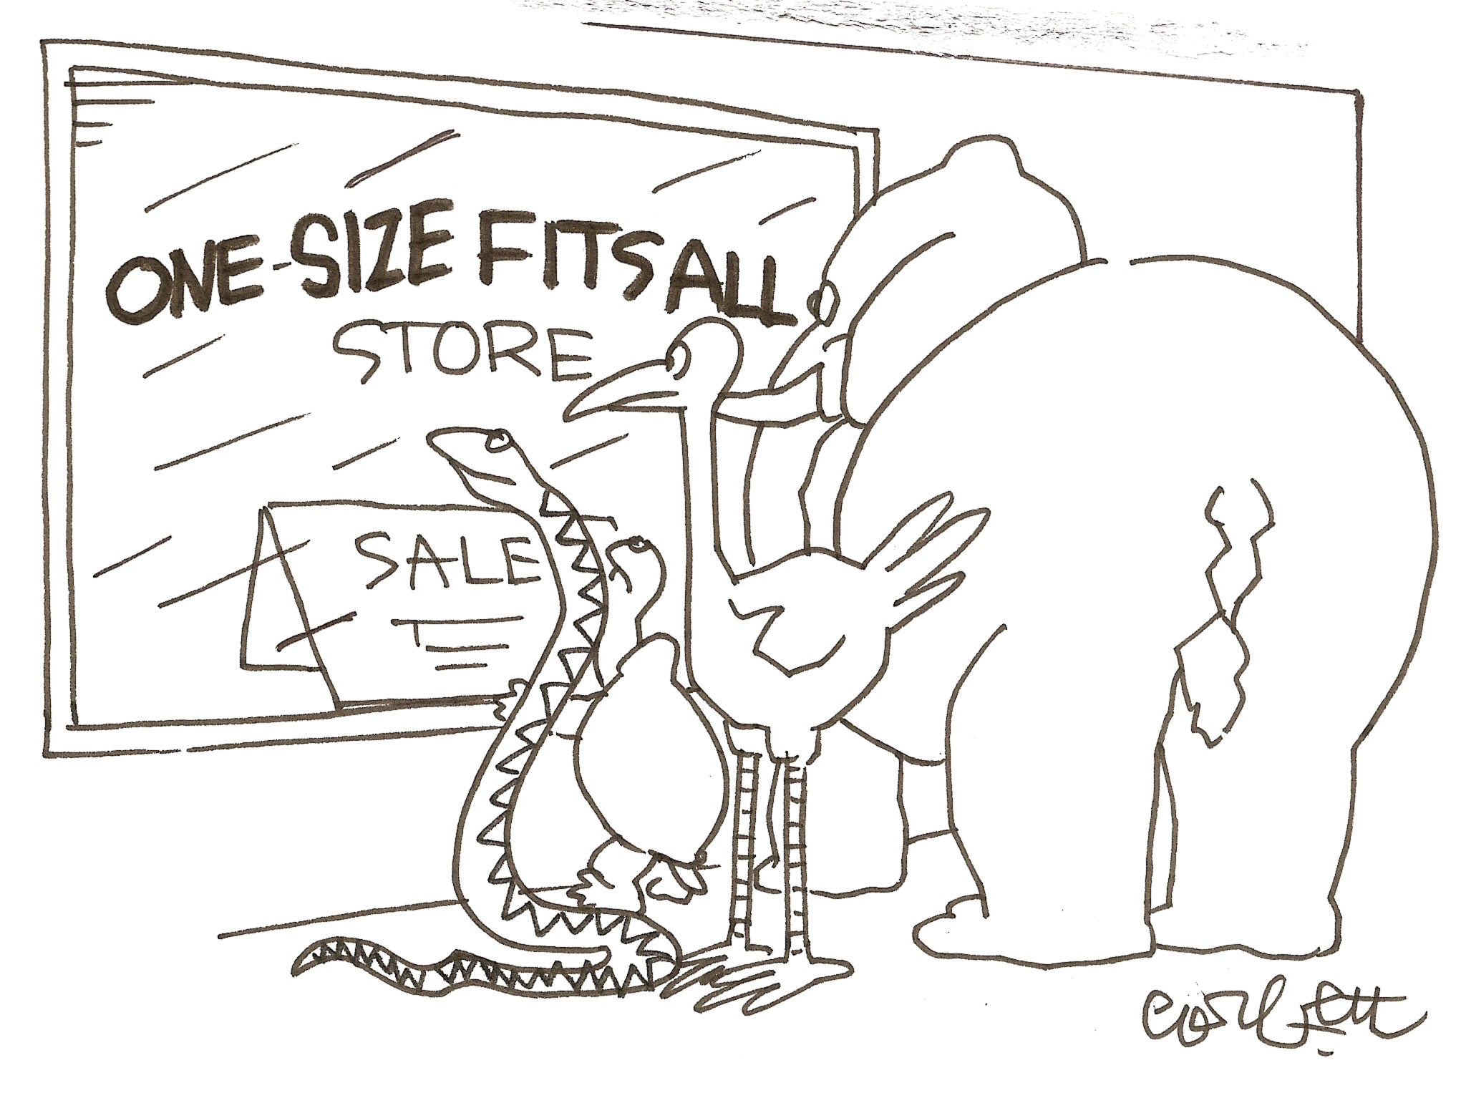

Slide 5
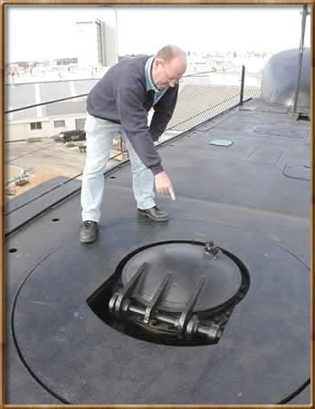

Standards 1.0
IMS Learning Tools Interoperability (LTI) 1.0
17 May 2010
IMS Common Cartridge 1.0
1 October 2008

Slide 6
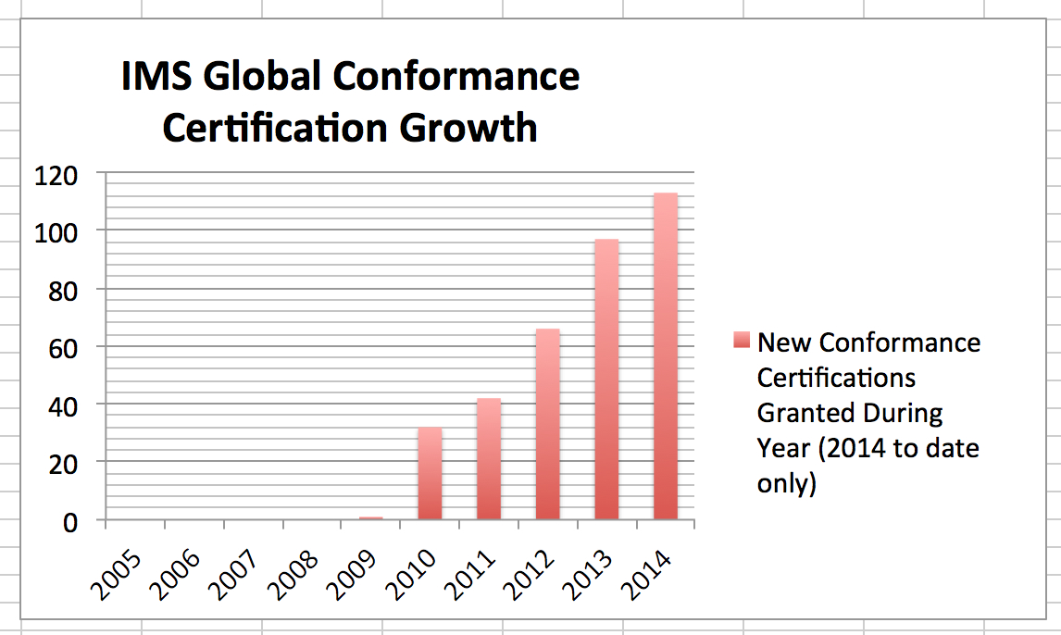
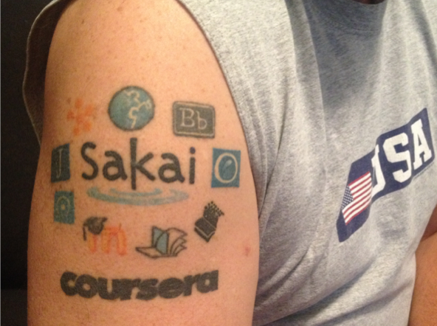

Slide 7


































Slide 8


Standards Next Gen
IMS Common Cartridge – 1.0, 1.1, 1.2, 1.3, 2.0
IMS Learning Tools Interoperability 1.0, 1.1, 2.0, 2.1
IMS LTI Content Item - 1.0
IMS LTI Membership Services – 1.0
Outcomes Management Service 2.0
IMS Caliper 1.0, 1.1
IMS OneRoster – 1.0
IMS CC / EPUB 3.0 Coordination

Slide 9
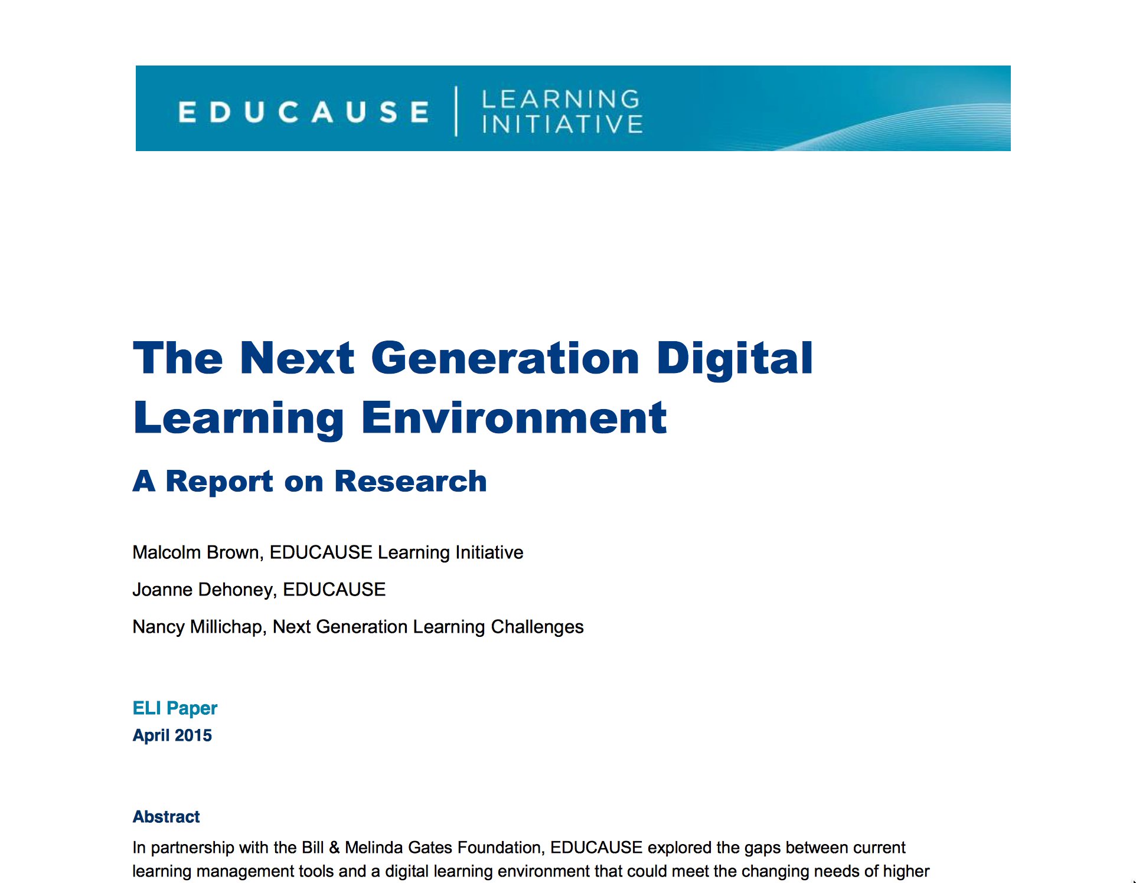
https://net.educause.edu/ir/library/pdf/eli3035.pdf

Slide 10
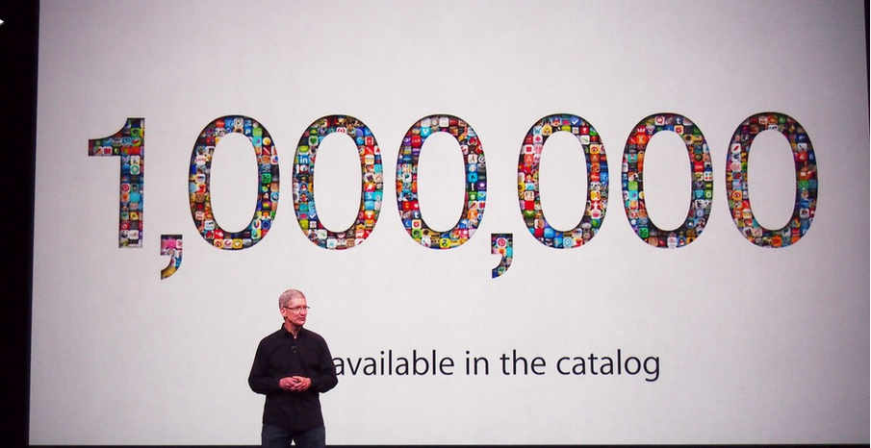
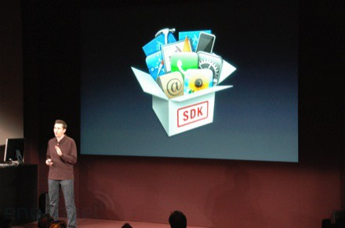
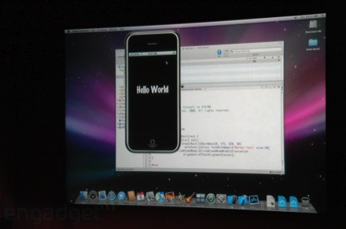
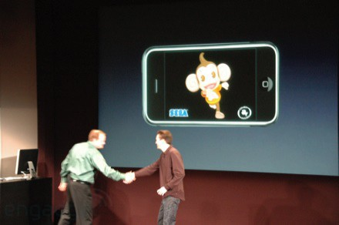
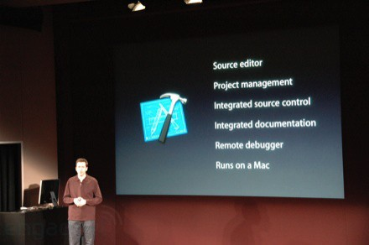
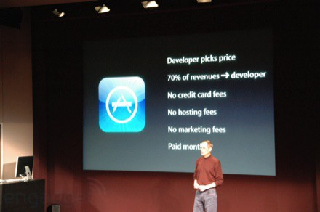
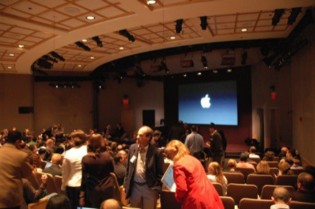
March 6, 2008 iPhone SDK Press Conference

Slide 11

http://planet-fall.deviantart.com/art/The-Monolith-80407794
https://pixabay.com/static/uploads/photo/2014/12/02/22/05/snowflake-554635_960_720.jpg

Slide 12
The Challenge
Need to develop more sophisticated standards for interoperability
Need to train 1000's of developers to read ,understand, and implement the standards
As standards improve they expand and get more complex
Impossible?

Slide 13
We need "WordPress"
A free downloadable off-the-shelf software package that gets people going quickly
Allow thousands of educational sites to be built and put into production by anyone

Slide 14
"EduPress"
An Learning Management System (LMS) of my own
An Open Educational Resource site of my own
A Learning Object Repository (LOR) of my own
A Learning Record Store (LRS) of my own
Millions of sites – millions of courses all similar with common capabilities structure and similar but at the same time unique and distinct

Slide 15
What is 次?
Software to allow anyone to build and deploy interoperable educational web sites, content, and learning tools

Slide 16
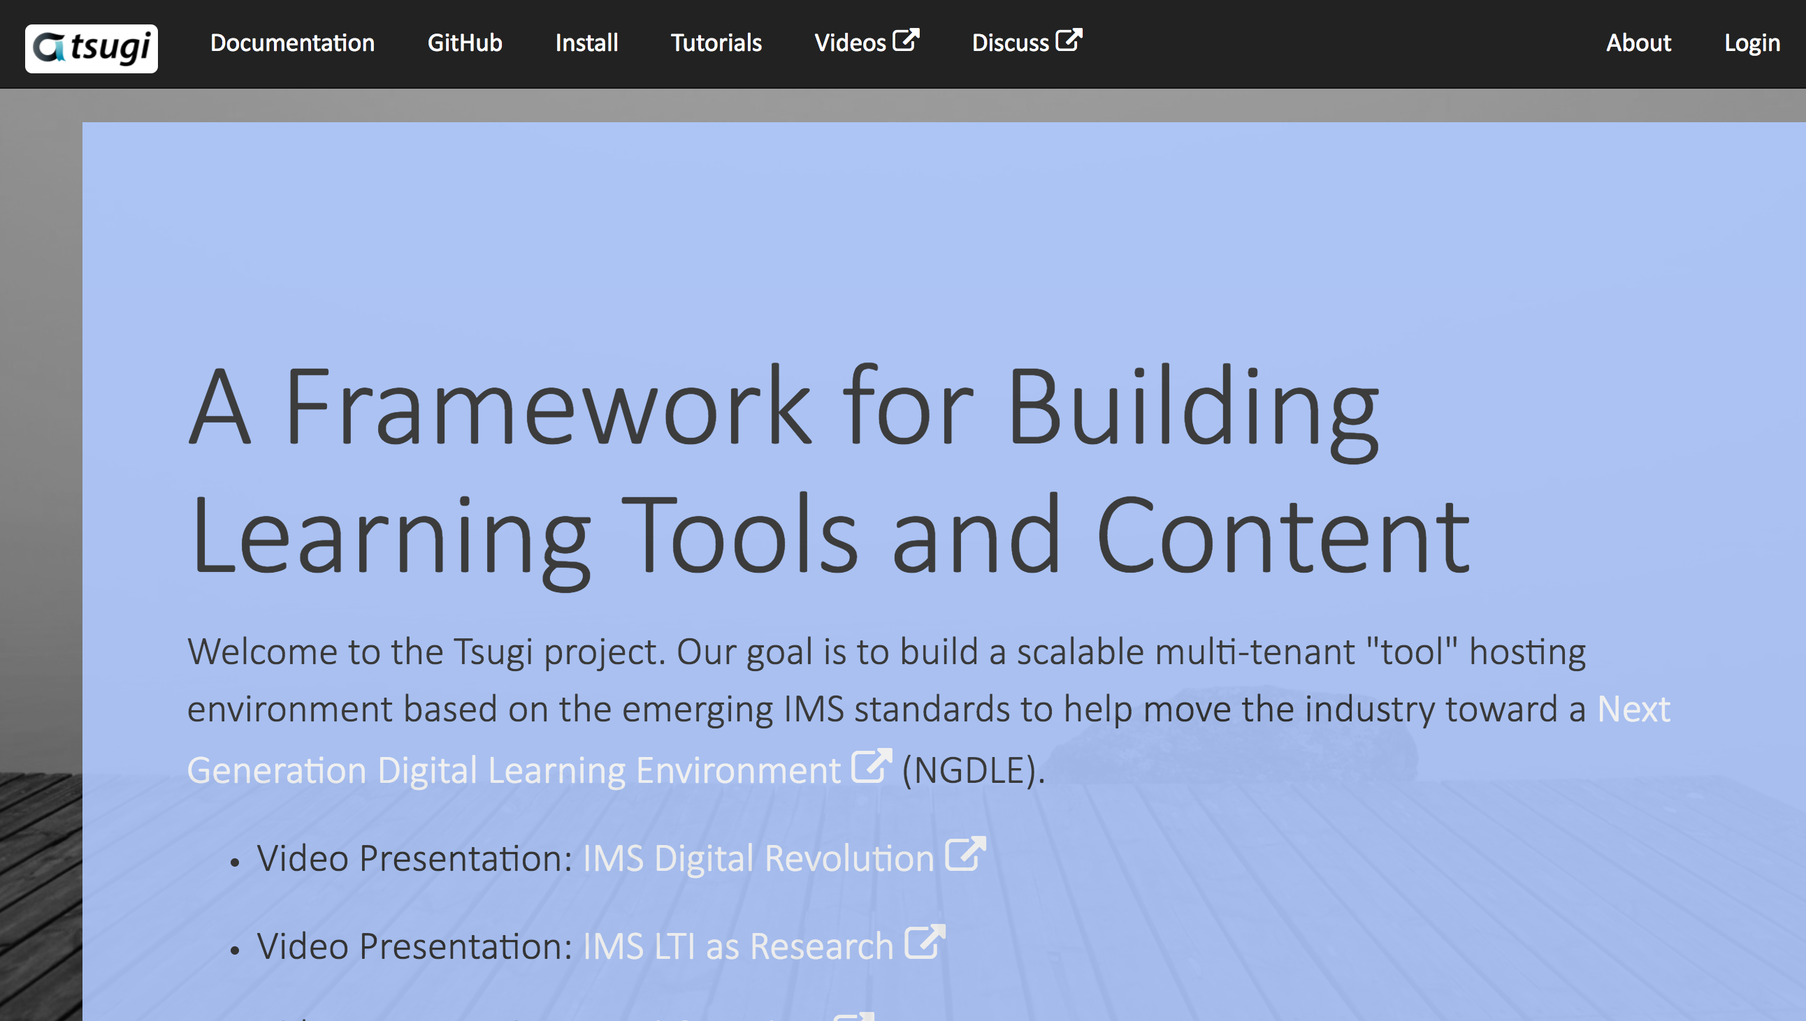
www.tsugi.org

Slide 17
Tsugi (次) is "EduPress"
Course-Oriented LMS / Standalone MOOC
App Store for Learning Applications
Course-Oriented Content Repository
API Libraries – PHP, Java, Python, Node...
Open source standards implementations
Training for Developers (www.tsugi.org)

Slide 18
Tsugi Store
Tsugi
Console
APP
Tsugi
PHP
MySQL
Database
APP
LMS/CMS
APP
CI
Canvas
Sakai
Coursera
Tsugi
Moodle
…
APP
Tsugi
Java
APP
APP
LTI
APP
Tsugi
Node
APP
APP
Python
Test
CC
Tsugi
LOR

Slide 19
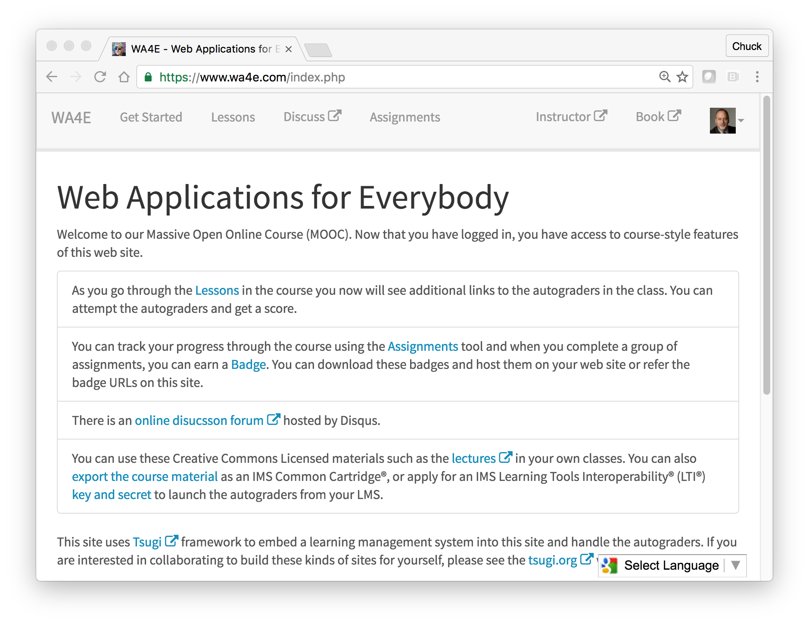
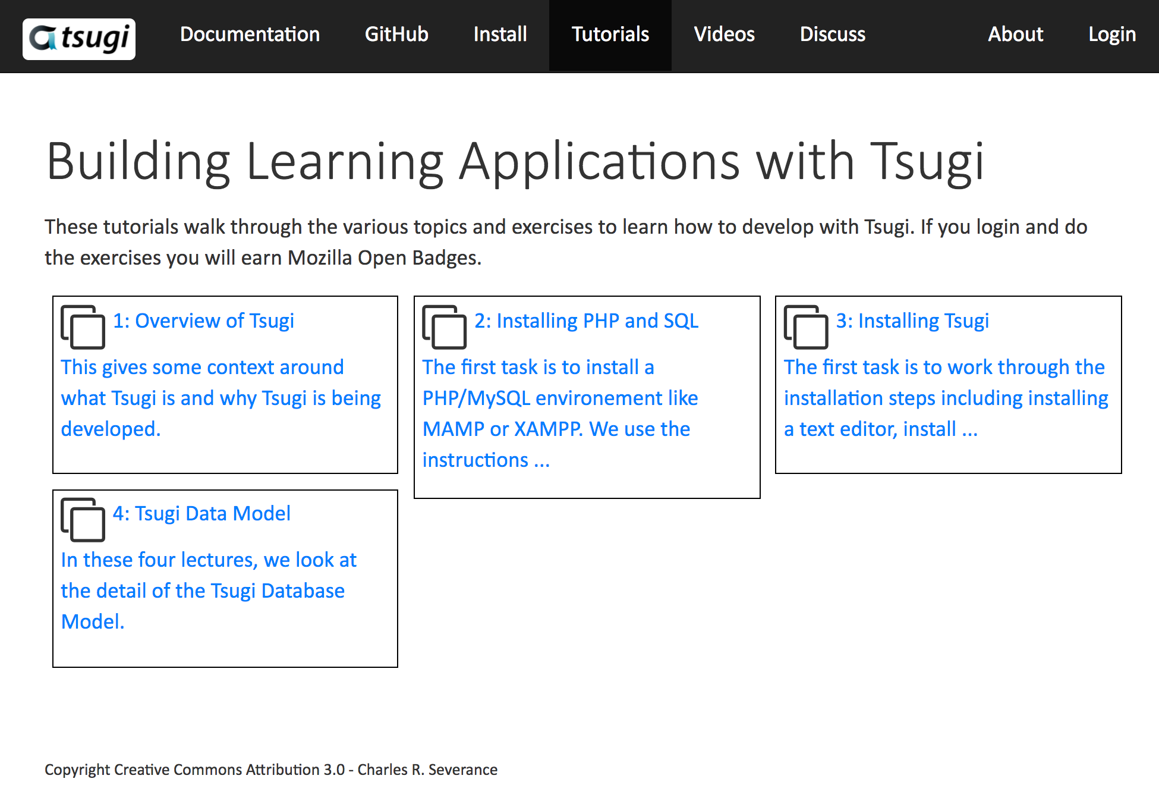
WA4E.com
tsugi.org

Slide 20

Use Cases
Campus IT Staff – App Store with locally owned data
Instructional Designers – Can focus programmers on building functionality – not reading standards
Faculty – Can build learning content once and use it over and over – content can be open
Book Authors - Can build a site with supporting materials and software with seamless integration into LMSs

Slide 21
Use Cases
OER Publishers – Excellent way to share truly reusable and remixable software and content
MOOC Platform – Small Schools / Single Course / Professional Society
EdTech Startups – A couple of students can have a seamlessly integrated learning tool at MVP in weeks
LMS Vendors – Can encourage their customers to easily build tools that work smoothly rather than break

Slide 22
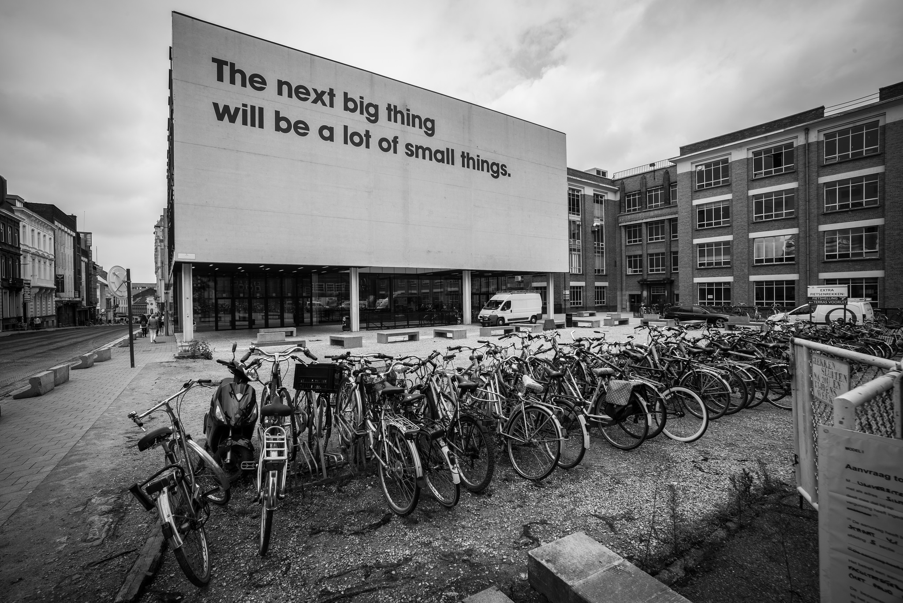
Source: Ian Dolphin

Slide 23




In building the NGDLE, open source will lead the market…

Slide 24

Tsugi is Ongoing Research
Growing, evolving based on experiments (0.3.1)
In incubation as a open source project in the Apereo Foundation (please join and support Apereo)
Participating in IMS Working Groups
Expect 1.0 release early 2018
Need friendly adopters
Need skilled collaborators
Raising funding for grad students, travel, etc
www.tsugi.org

Slide 25
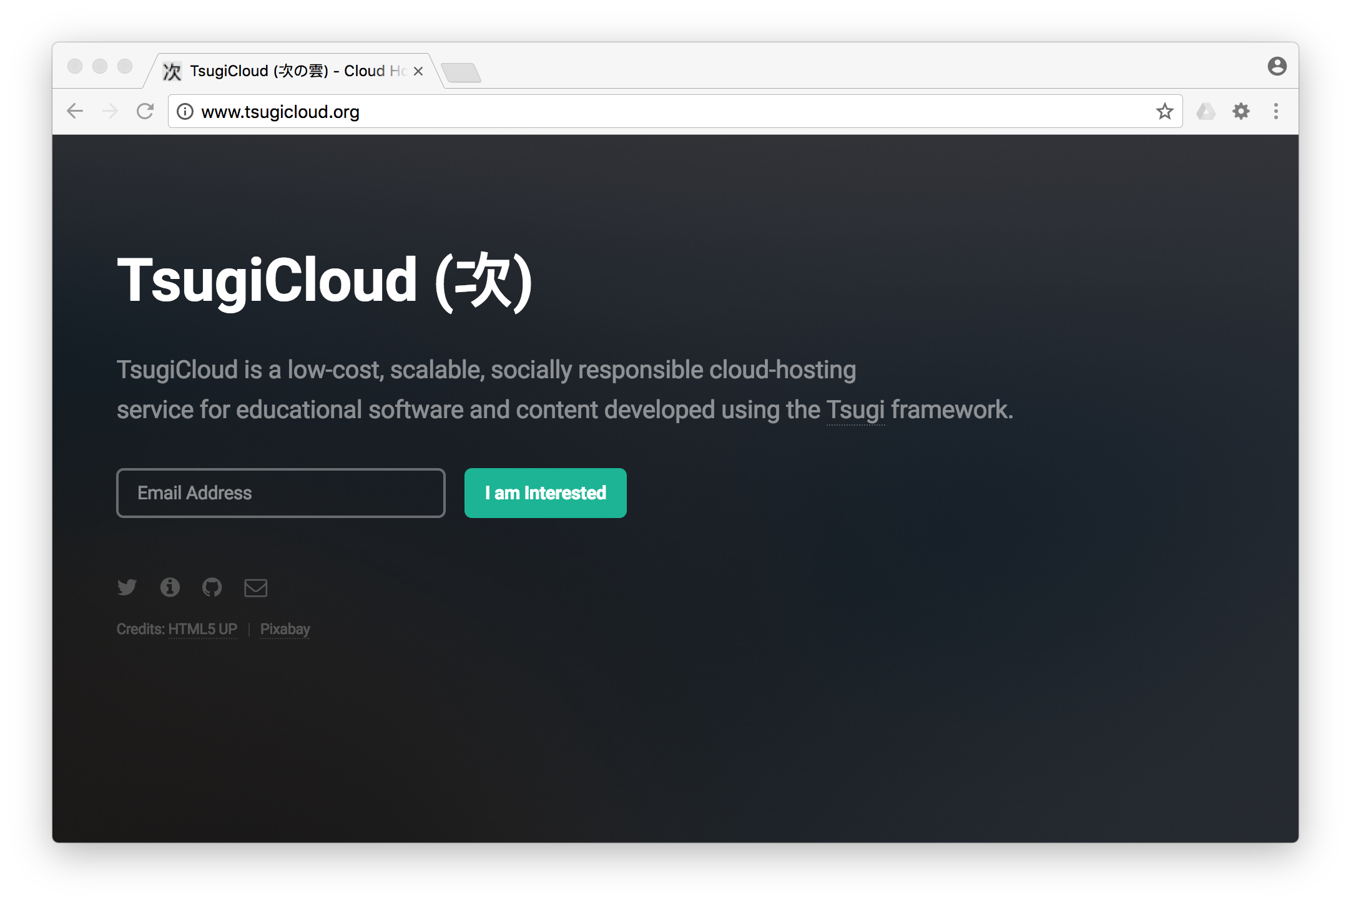

Slide 26
A Few Questions…
Show me how beautiful an LTI Tool's UX can be
Show me the Tsugi Learning Object Repository integrated into Canvas or Sakai
Show me how you use Tsugi to support your Coursera MOOCs
Show me how to set up a Tsugi App Store for my Campus
Show me how easy it is to add a new application to Tsugi
I teach a Computer Science Capstone course…
Show me where to start learning more...

